Slide 1
MANY ELECTRON WAVEFUNCTION
PANKAJ KUMAR

Slide 2
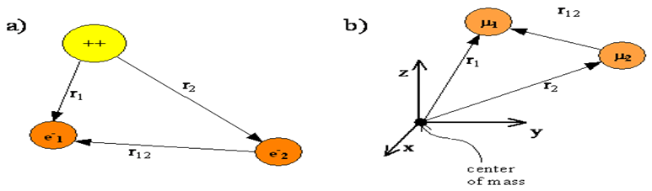
HELIUM ATOM -:
The nuclei for multi-electron atoms are so much heavier than an electron that the nucleus is assumed to be the center of mass and fixing the origin of the coordinate system at the nucleus allows us to exclude translation motion of the center of mass from our quantum mechanical treatment.

Slide 3
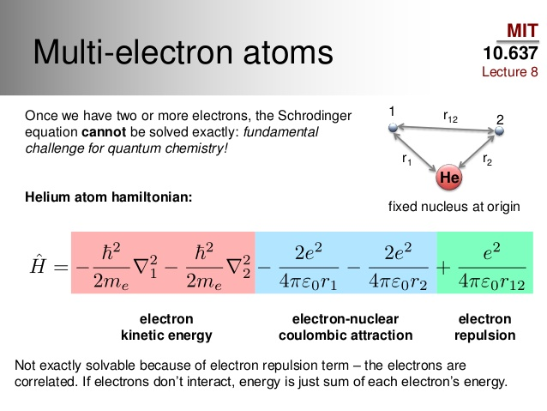

Slide 4
TO SOLVE THE SCHRODINGER EQUATION FOR HELIUM ATOM-: 1. The approximation that we consider in this section is the neglect of the electron-electron interaction term.
Neglecting the electron repulsion term simplifies the helium atom Hamiltonian to a sum of two hydrogen-like Hamiltonians that can be solved exactly. Ĥ(r₁,r₂)=Ĥ(r₁)+Ĥ(r₂) Ĥ(r₁)φ(r₁)=E₁φ(r₁) Ĥ(r₂)φ(r₂)=E₂φ(r₂)

Slide 5
the wavefunction can be approximated as a product of two single-electron hydrogen-atom wavefunctions . ψ(r₁,r₂)≈φ(r₁)φ(r₂) the energy eigenvalue associated with the product wavefunction is the sum of the one-electron energies associated with the component single-electron hydrogen-atom wavefunctions. E(He)=E₁+E₂ The energy obtained by neglecting the interaction between the electrons is -108.8ev. The actual energy is -79.0ev.

Slide 6
2. Perturbation Theory The perturbation term corrects the previous Hamiltonian to make it fit the new problem. In this way the Hamiltonian is built as a sum of terms, and each term is given a name. For example, we call the simplified or starting Hamiltonian, Ĥ0 , the zero order term, and the correction term Ĥ1 , the first order term. Ĥ=Ĥ₀+Ĥ₁+Ĥ₂+⋯ the wavefunctions are also built as a sum of terms, with the zero-order terms denoting the exact solutions to the zero-order Hamiltonian and the higher-order terms being the corrections. ψ=ψ₀+ψ₁+ψ₂+⋯
Similarly, the energy is written as a sum of terms of increasing order. E=E₀+E₁+E₂+⋯

Slide 7

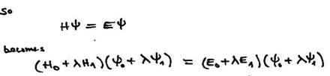
Now first we solve the zero order perturbation term- Ĥ₀ψ₀=E₀ψ₀ After this we solve the first order perturbation term- Ĥ₀ψ₁+ Ĥ₁ψ₀=E₀ψ₁+E₁ψ₀ for solving this first order term we multiply from the left by ψ*₀ and integrate over all the coordinates . ∫ψ₀*Ĥ₀ψ₁dτ+∫ψ₀* Ĥ₁ψ₀dτ=E₀∫ψ₀*ψ₁dτ+E₁∫ψ₀*ψ₀dτ

Slide 8

As we know Ĥ₀ is Hermitian ∫ψ₀*Ĥ₀ψ₁dτ=∫(Ĥ₀Ψ₀)*Ψ₁dτ=E₀∫Ψ₀*Ψ₁dτ By replacing this in previous equation we obtain E₁=∫ψ₀*Ĥ₁ψ₀dτ For the helium atom, the zeroth order perturbation term consist of = Ĥ₀ = and the energy E₀ obtained is -108.8ev. The first order perturbation term consist of = Ĥ₁ =

Slide 9
And the energy E₁ obtained is +34.0 eV . So now the total approximate energy obtained is Eapprox=E₀+E₁= −74.8eV And the actual energy is -79.00eV. Here we take only upto first order perturbation term because the higher order term are very less in magnitude and they cause negligible effect in total energy. And the evaluation of these higher term is also not so easy.

Slide 10


3. Variational Method The variational principle means that the expectation value for the binding energy obtained using an approximate wavefunction and the exact Hamiltonian operator will be higher than or equal to the true energy for the system.
The Variational Principle says that the best value for any variable parameter in an approximate wavefunction is the value that gives the lowest energy for the ground state; i.e., the value that minimizes the energy. The variational method is the procedure that is used to find the lowest energy and the best values for the variable parameters.

Slide 11


let our trial wavefunction is-:
the energy obtained after minimizing the energy equation by putting the trial wave function in our variational equation.
where Eₕ=27.2eV.
E(trial)=-77.4563eV.
and our exact energy is -79.0eV.

Slide 12


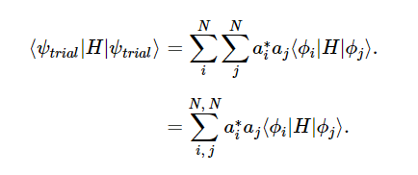
Linear variational Method -:
In linear variational Method our trial wave function is linear combination of independent function.
the energy equation is
Now,solving numerator and denominator independently.

Slide 13





we write
so our term become
our denominator is
we write

Slide 14
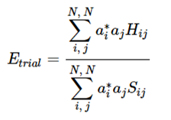



Now after solving wee obtain-:
now,we want to minimize the energy with respect to the coefficients so,

Slide 15
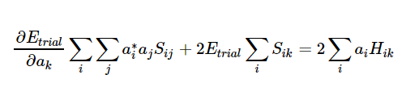

since our coefficients are independent
H_{ij}=H_{ji}
S_{ij}=S_{ji}
and our equation simplifies to-:
since,
this is called as the secular equation.

Slide 16
We therefore have N simultaneous secular equations in N unknowns. These equations can also be written in matrix notation, and for a non-trivial solution (i.e. ci != 0 for all i), the determinant of the secular matrix must be equal to zero.
|H_{ik}-ES_{ik}|=0
The resulting algebraic equation can be solved to obtain the energies E.
and then we can also calculate the best possible for the coefficient.

Slide 17
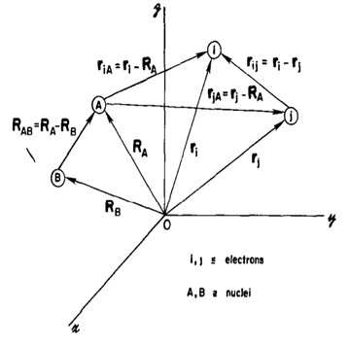
Many particle system-:
suppose there are N electrons and M nucleus
now our Hamiltonian is-:
Ĥ=(K.E. of electron)+(K.E. of nucleus)+(P.E. of nucleus-electron)+(P.E. of nucleus- nucleus)+(P.E. of electron-electron)

Slide 18
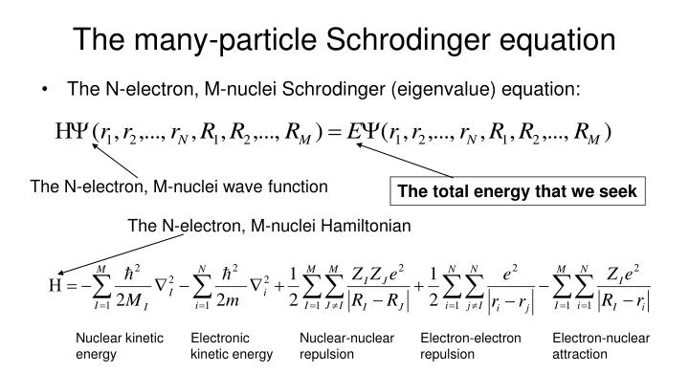

Slide 19
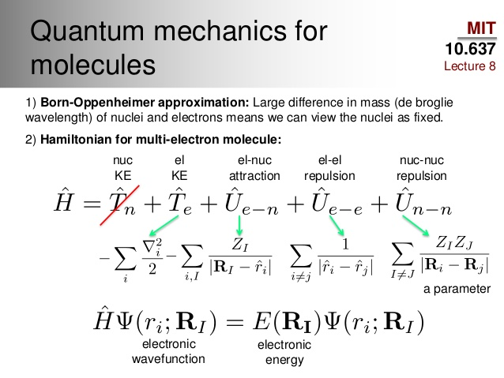

Slide 20
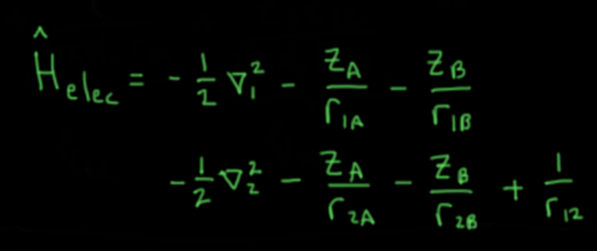

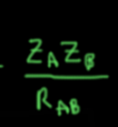
Here assumption is made that the electron are moving in the field of fixed nuclei. So we neglect the kinetic energy term of nucleus and the nucleus-nucleus interaction term is constant and as we know that the eigenfunction(wavefunction) not depend on the constant term. However, this term having effect on eigenvalue and we can add this directly to eigenvalue to find the total energy. So now we are left with electron Hamiltonian-: And along with that a constant term-:

Slide 21



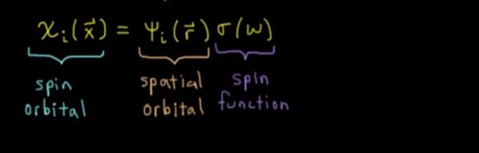
Spin orbital-: it is a representation of single electron wavefunction.
Spatial orbital -> is a function of position vector(r) and describing the spatial distribution of electron and we can also calculate the probability of finding the electron in the small element .
Spatial orbital= For completely describe an electron it necessary to specify its spin.So for describing the spin we have a spin function for up-spin = for down spin = So Spin orbital is -:

Slide 22

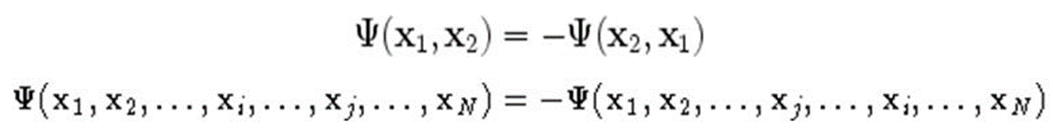
Antisymmetry principle-: The wavefunction for an N-electron system is the function of x1,x2,x3,…….n. That is, where x1,x2,.. is co-ordinate of N electrons . A many electron wave function must be antisymmetric with respect to the interchange of coordinate of any two electron.

Slide 23

Hartree Product -: As we seen the appropriate wave function describing a single electron is spin orbital. And now wave function for N-electron. Assumption->electron-electron interaction zero.
V_{ee}=0 So our hamiltonian operator can be written as
So now if our Hamiltonian is the sum of individual one electron Hamiltonian then the wavefunction is product of spin orbital of individual electron.

Slide 24
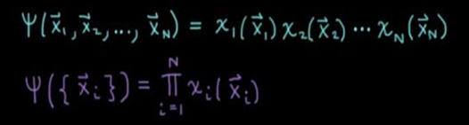

-> Electrons are not indistinguishable.
->Wavefunction is not anti symmetric with respect to the interchange
of coordinate of two electron.

Slide 25


Slater determinant-:
The hartree product does not satisfy the anti symmetry principle. So
for obtaining the antisymmetrized wave function we can have a linear combination of the hartree product of all possible combination.

Slide 26
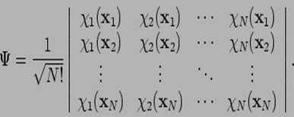
The antisymmetric wavefunction can be rewritten as a determinant
and is called as slater determinant.
In which row corresponds to electron and column correspond to spin orbital.
interchanging the coordinate of two electron correspond to interchange of two row of the slater determinant and which change the sign of determinant.Hence,it follow the antisymmetric principle.

Slide 27


Hartree fock approximation-:
hartree fock equation-:
f(i)𝝌(х_{i})=ε𝝌(x_{i})
here f(i) is an effective one-electron operator ,called the fock operator.
where is the average potential experience by the ith electron due to the presence of the other electron. so now the many electron problem is replaced with one electron problem in which electron electron repulsion is treated in average way.

Slide 28
The procedure for solving the hartree fock equation is called self-consistent-field (SCF).
guess spin orbital
calculate V_{hf} for each electron
solve eigenvalue equation
obtain new spin orbitals
Is SCF
converged
NO
YES
DONE

Slide 29

Excited Determinants
The solution of hartree fock eigenvalue problem yield the a set {𝝌_{k}} of
orthonormal hartree fock spin orbitals with orbital energies {εₖ} .
so total 2k orbitals are there k with up spin and k with down spin.
the N spin orbital with lowest energies are called the occupied orbital and the remaining 2k-N orbital are virtual or unoccupied orbital.
In hartree fock we only discuss about the ground occupying spin orbital but in real life there are many cases available.
we have 2k orbitals available (k with up spin & k with down spin) and there are N electrons so total possible combination is -

Slide 30



hartree fock ground state-: All the electrons are in ground state.
Singly excited state-: A single electron is excited from ground state a to r.
Doubly excited state-: two electrons is excited from ground state (a,b) to excited state(r,s).
M fold excited state-: M electron excited occur.

Slide 31
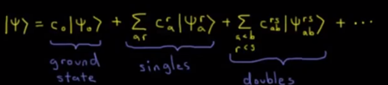

So, for forming the exact wave function for any state as a linear combination of all possible combination.
let’s take an example of H₂ model -:
N=2 (2-electron)
2 basis function it means 4 spin orbital(2 up spin and 2 down spin)
so total possible combination is=
(4!)/((2!)(2!))=6 unique determinants
ground state-:

Slide 32
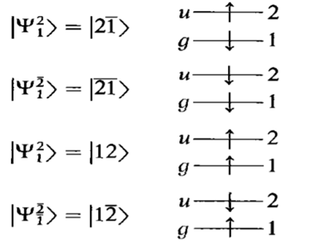
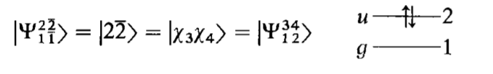
singly excited state-:
Doubly excited state-:
So,for exact wave function we need to have the linear combination of these
6 determinants.

Slide 33
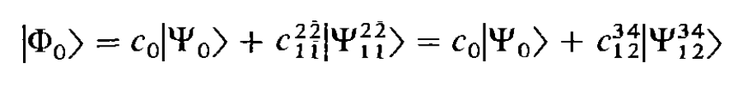
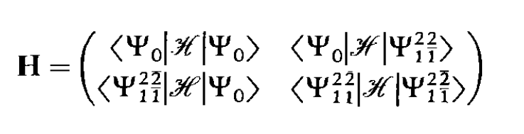
In the hartree fock ground state has two electron in gerade orbitals is of g symmetry .The doubly excited state two electrons are in ungerade orbitals so it’s also of g symmetry,on the other hand in singly excited state one electron in gerade and another one in ungerade orbital therefore these of u symmetry.and the exact ground state wavefunction(|Φ₀〉) of H₂ is of g symmetry.therefore only determinants of g symmetry can appear in the expansion of (|Φ₀〉) .
So, for finding the exact coefficients which describe the wave function |Φ₀〉and the exact energy can be found by diagonalizing the full CI matrix.

Slide 34
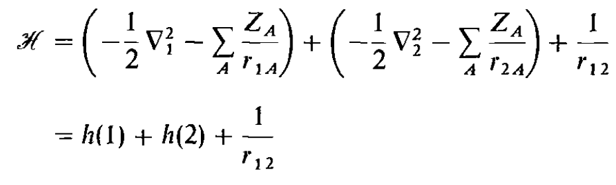
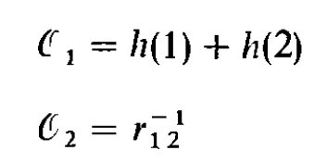
So,for calculating the element of matrix -:
hamiltonian operator for two electron is
where h(1) is the hamiltonian for electron-one and h(2) is hamiltonian for electron-two.
Now, we separate the total hamiltonian in to one and two electron parts.

Slide 35
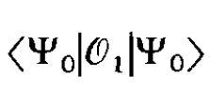


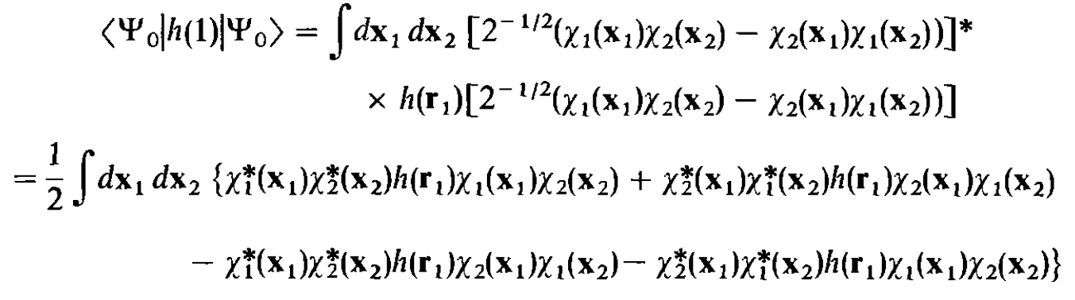
Now first solve the one electron term
= +
the first term is -:

Slide 36


So we can also solve using same procedure and
=
so we can write-
this integral in this expression is one electron integral .
Physicists notation-:
Chemist notation-:

Slide 37

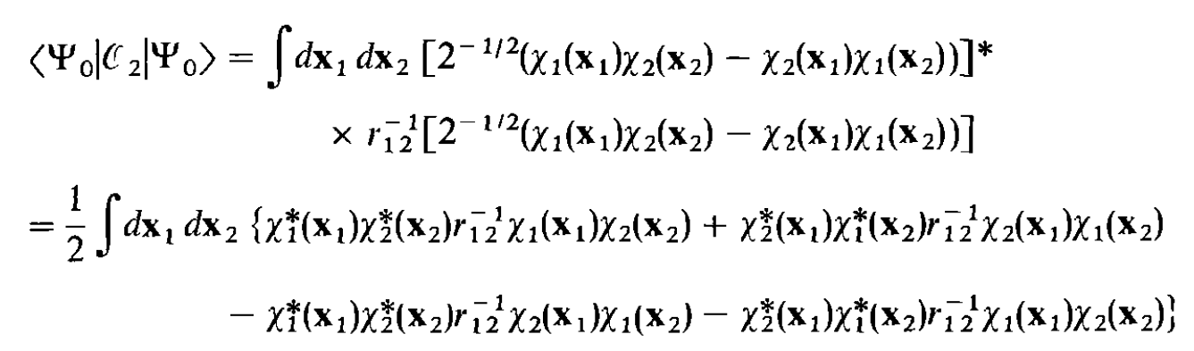
Now evaluating the
Since r₁₂=r₂₁ ,we can interchange the dummy variable of the integration then second term equal to first term and third term equal to fourth term.

Slide 38
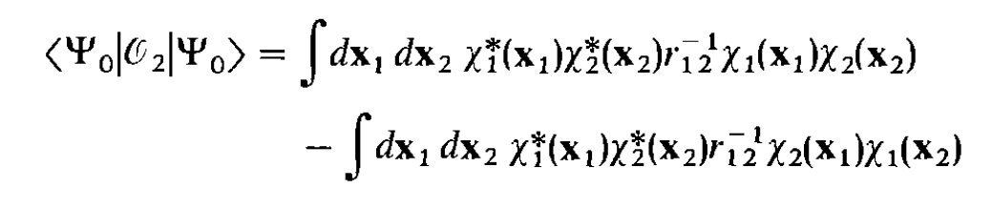


So we can write -
The integral in this expression are two electron integral.
Physicists notation-:
Chemists notation-:

Slide 39

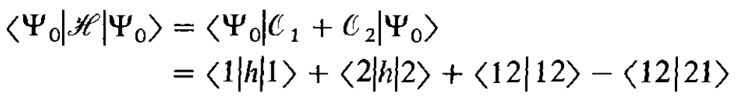
So finally the solution of term
And similarly we can obtain the other element of full CI matrix and then we can obtain the coefficients for the exact ground state wavefunction .

